Slide 1
IOT BASED AQUACULTURE MONITOR SYSTEM
Team members:
AARTHI E 311423148001
AARTHI P 311423148002
SUSHMITHA K 311423148049
JAIYA NANDHANA S R 311423148019
ASHOK 311423148004

Slide 2
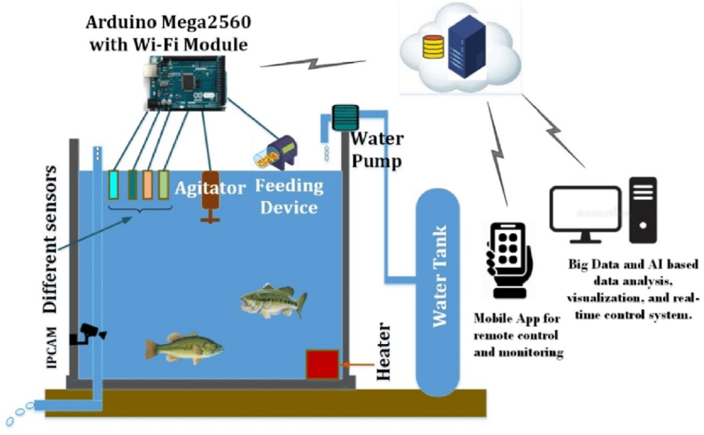
Introduction
An IoT-based aquaculture system uses smart sensors to monitor water quality in real time, ensuring healthy conditions for aquatic life. It enables remote monitoring, timely alerts, and improves efficiency in fish farming.

Slide 3
Objectives
Monitor Water Parameters (Temperature, Ph, Oxygen) In Real-time.
Log Data For Analysis And Trends.
Access System Remotely Via Web/Mobile.
Alert Users To Abnormal Conditions.
Automate Feeding And Aeration.
Boost Fish Health And Farm Yield.

Slide 4
Literature Review / Background
Manual monitoring in traditional aquaculture is slow and error-prone.
Water quality directly affects fish health and growth.
IoT enables real-time sensing, data collection, and control.
WSN transmits sensor data to central systems.
Studies show IoT improves fish survival and yield.
Cloud/mobile access supports remote monitoring and alerts.
Automation reduces labor and increases efficiency.

Slide 5
Methodology
Deploy Sensors: Place pH, temperature, and DO sensors in water.
Collect Data: Use microcontrollers (e.g., Arduino/Raspberry Pi).
Transmit Data: Send to cloud via Wi-Fi/GSM.
Store Data: Use IoT platforms like Blynk or Firebase.
Monitor Remotely: View data on web or mobile app.
Send Alerts: Notify users of abnormal conditions.
Automate Control: Manage feeders/aerators based on data.
Analyze Trends: Use past data for system optimization.

Slide 6
System Design / Architecture

Slide 7
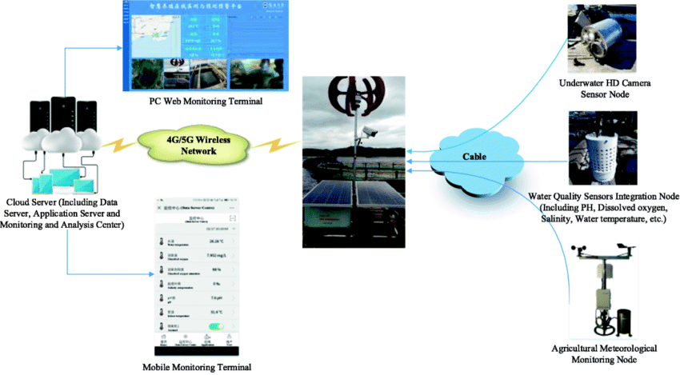
Results & Discussion
Real-time monitoring improved water quality management, significantly reducing fish mortality. Automated feeding optimized feed usage, leading to lower operational costs. The integration of temperature and pH sensors provided accurate environmental data, enabling timely interventions. Additionally, fish growth tracking allowed farmers to adjust feeding schedules effectively, improving overall yields. Together, these IoT-based implementations enhanced productivity and promoted sustainability in aquaculture operations.

Slide 8
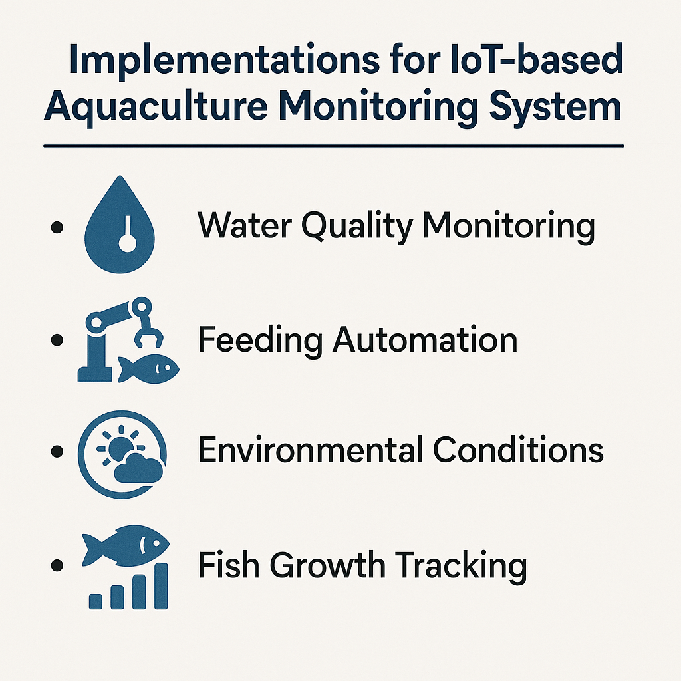
Implementation
Microcontroller: Arduino/Raspberry Pi/ESP32 collects data
Communication: Wi-Fi/LoRa/NB-IoT/GSM to cloud/server
Cloud: Store data on AWS/Azure/Google Cloud with Firebase/MySQL/NoSQL
Analytics: Anomaly detection and AI-based health monitoring
UI: Mobile/web dashboard with alerts
Sensors: pH, temp, DO, turbidity, ammonia, water & feed levels
Automation: Remote control of aerators, feeders, pumps
Power: Solar/battery for off-grid use
Security: Encryption and user authentication
Maintenance: Sensor calibration and updates

Slide 9
Challenges & Solutions
1. Data Collection & Quality
Challenge: Sensor accuracy for water
quality monitoring
Solution: Regular calibration & automated checks
2. IoT Device Integration
Challenge: Compatibility among devices from different manufacturers
Solution: Use standardized protocols (MQTT, HTTP)
3. AI Model Development
Challenge: Lack of sufficient diverse training data
Solution: Continuous testing and validation with real data
4. User Interface & Experience
Challenge: Designing for users with varied technical skills
Solution: Involve users in design for intuitive interface

Slide 10
Market Status
The Global Precision Aquaculture Market, Encompassing Iot-based Monitoring, Was Valued At USD 529.47 Million In 2023 And Is Projected To Reach USD 1,767.15 Million By 2032, Growing At A CAGR Of 14.38%. Globenewswire
The Broader Iot For Fisheries And Aquaculture Market Is Expected To Attain A Value Of Usd 1.23 Billion By 2030.
Integration Of Ai And Iot: The Combination Of Ai And Iot Is Enabling Predictive Analytics, Allowing For Proactive Management Of Water Quality, Fish Health, And Environmental Conditions. Market Research Intellect
Blockchain For Traceability: Implementing Blockchain Technology Enhances Traceability In The Seafood Supply Chain, Ensuring Transparency And Meeting Consumer Demand For Responsibly Sourced Seafood.

Slide 11
Future Scope
AI Integration: Predictive analytics for fish health and yield forecasting.
Blockchain Traceability: Secure tracking of fish from farm to market.
Advanced Sensors: Use of biosensors for detecting diseases early.
Remote Management: Global access and control via cloud platforms.
Energy Efficiency: Integration with solar-powered systems.
Automated Drones: For aerial monitoring and feeding.
Big Data Analysis: Optimization of feeding schedules and environmental parameters.
Mobile App Expansion: Enhanced user interfaces for real-time alerts and insights.

Slide 12
Regional Insights
Asia-Pacific: Leading the market due to rapid adoption of advanced technologies and a burgeoning aquaculture industry, with countries like China, India, Indonesia, and Japan at the forefront. Global Growth Insights+3PR Newswire+3WhaTech+3
Europe: Experiencing significant growth driven by stringent environmental regulations and a strong emphasis on sustainability, with nations such as Norway, Scotland, and Denmark leading in smart aquaculture adoption. Mark Wide Research+1Global Growth Insights+1
North America: Witnessing steady growth fueled by technological innovation and a focus on sustainable aquaculture practices, particularly in the United States and Canada.

Slide 13
Conclusion
The IoT-based aquaculture monitoring system provides an efficient and reliable way to maintain optimal water conditions, ensuring healthier aquatic life and higher productivity. By enabling real-time monitoring, remote access, and automation, the system reduces manual effort and minimizes risks of fish loss. Overall, it supports sustainable aquaculture practices and enhances farm management through data-driven decisions.

Slide 14
References
Tzounis, A., Katsoulas, N., Bartzanas, T., & Kittas, C. (2017). Internet of Things in agriculture, recent advances and future challenges. Biosystems Engineering, 164, 31–48. https://doi.org/10.1016/j.biosystemseng.2017.09.007
Raj, T., Gaurav, A., & Yadav, A. (2020). IoT based smart aquaponics system using NodeMCU. Proceedings of the International Conference on Intelligent Sustainable Systems (ICISS). IEEE Xplore Link
Santhosh, M., & Jayashree, D. (2021). IoT-based water quality monitoring system for aquaculture. Materials Today: Proceedings, 45, 5569–5575. https://doi.org/10.1016/j.matpr.2021.02.506
Ali, M. A., Al-Ali, A. R., & Abughazaleh, A. (2021). IoT-based aquaculture system: A review. Journal of King Saud University - Computer and Information Sciences. https://doi.org/10.1016/j.jksuci.2021.10.002
Verma, R., & Singh, B. (2022). Design and development of IoT-based water quality monitoring system. Smart Innovation, Systems and Technologies, 226, 45–54. Springer Link
Boopathy, R., & Tamilselvi, S. (2020). An IoT-based smart fish farm monitoring system. International Journal of Engineering Research & Technology (IJERT), 9(7). https://www.ijert.org/an-iot-based-smart-fish-farm-monitoring-system
Rajeswari, K., & Abinaya, G. (2020). Smart aquaculture monitoring using IoT with machine learning. International Journal of Scientific & Technology Research, 9(3), 4202–4205.
Wang, X., & Li, J. (2020). Real-time water quality monitoring for aquaculture based on wireless sensor networks. Sensors, 20(17), 4784. https://doi.org/10.3390/s20174784
FAO (2021). The State of World Fisheries and Aquaculture. https://www.fao.org/3/ca9229en/ca9229en.pdf
IBM Research (2020). AI and IoT for Smart Aquaculture. https://research.ibm.com

Slide 15
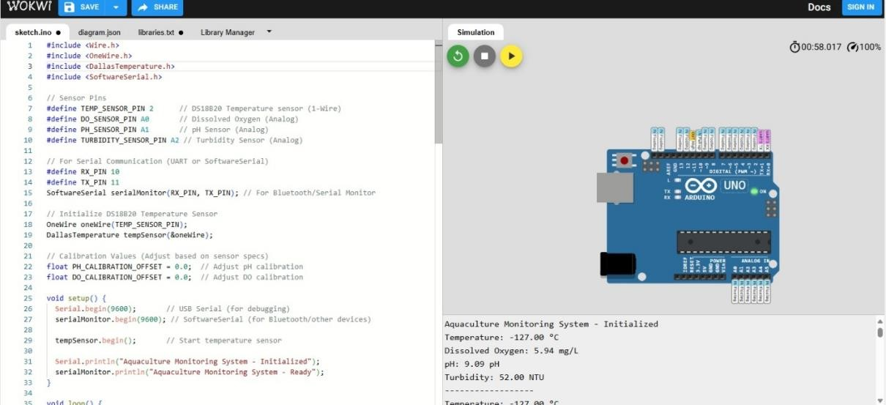
Code Implementation & Output

Slide 16
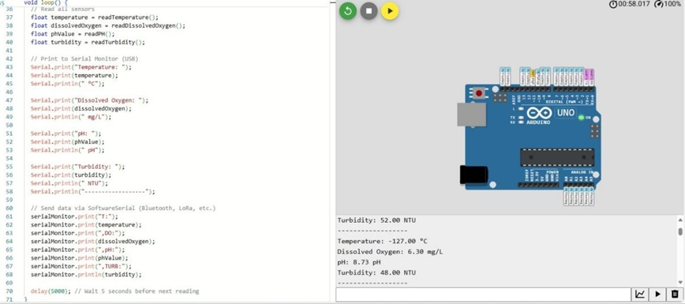

Slide 17
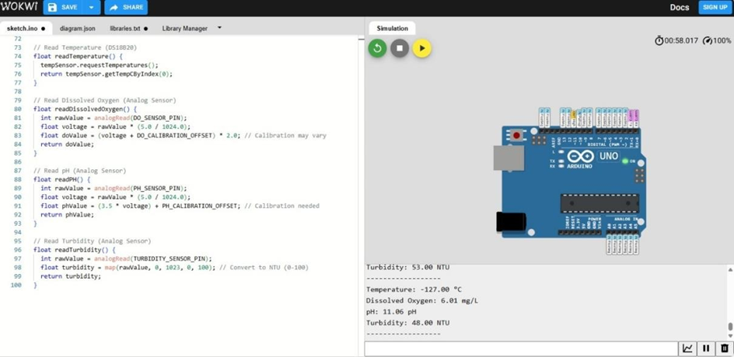

Slide 18
Thank You!

